Slide 1
Components and Schematics

Slide 2
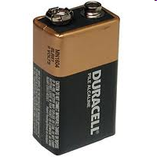
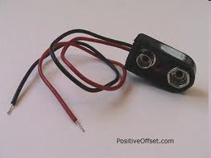
Battery
+
-
schematic
Leads to connect the battery
Provides DC power

Slide 3
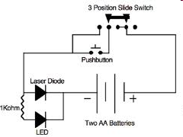
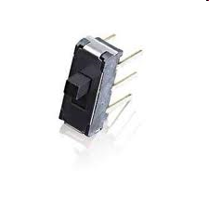
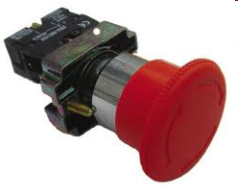
Switches
Turn on/off

Slide 4
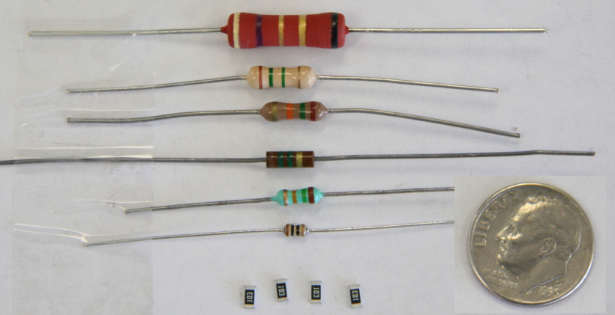
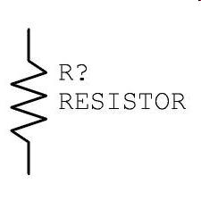
Resistors
used to limit and/or control the voltage and current in an electronic circuit.
4
Notes:
Size comparison of common resistor package styles.
Component Identification
Digital Electronics TM
1.1 Foundations and The Board Game Counter
Project Lead The Way, Inc.
Copyright 2009
4

Slide 5
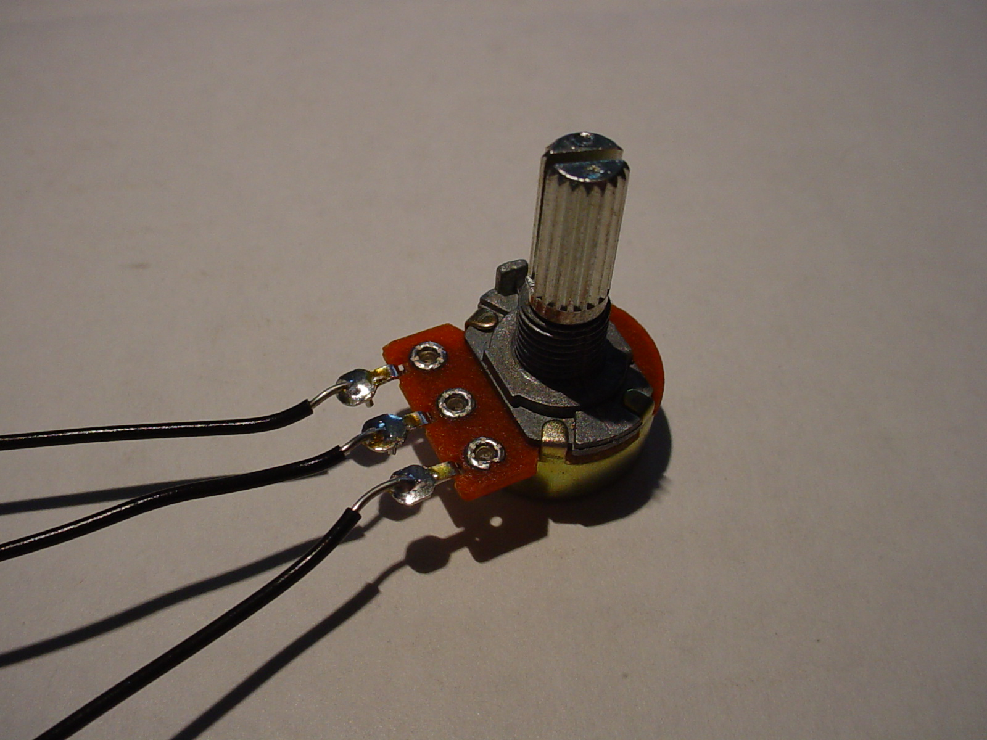
Potentiometer
+
9 volts
-
Variable
resistor
100 ohms
Flow of current

Slide 6
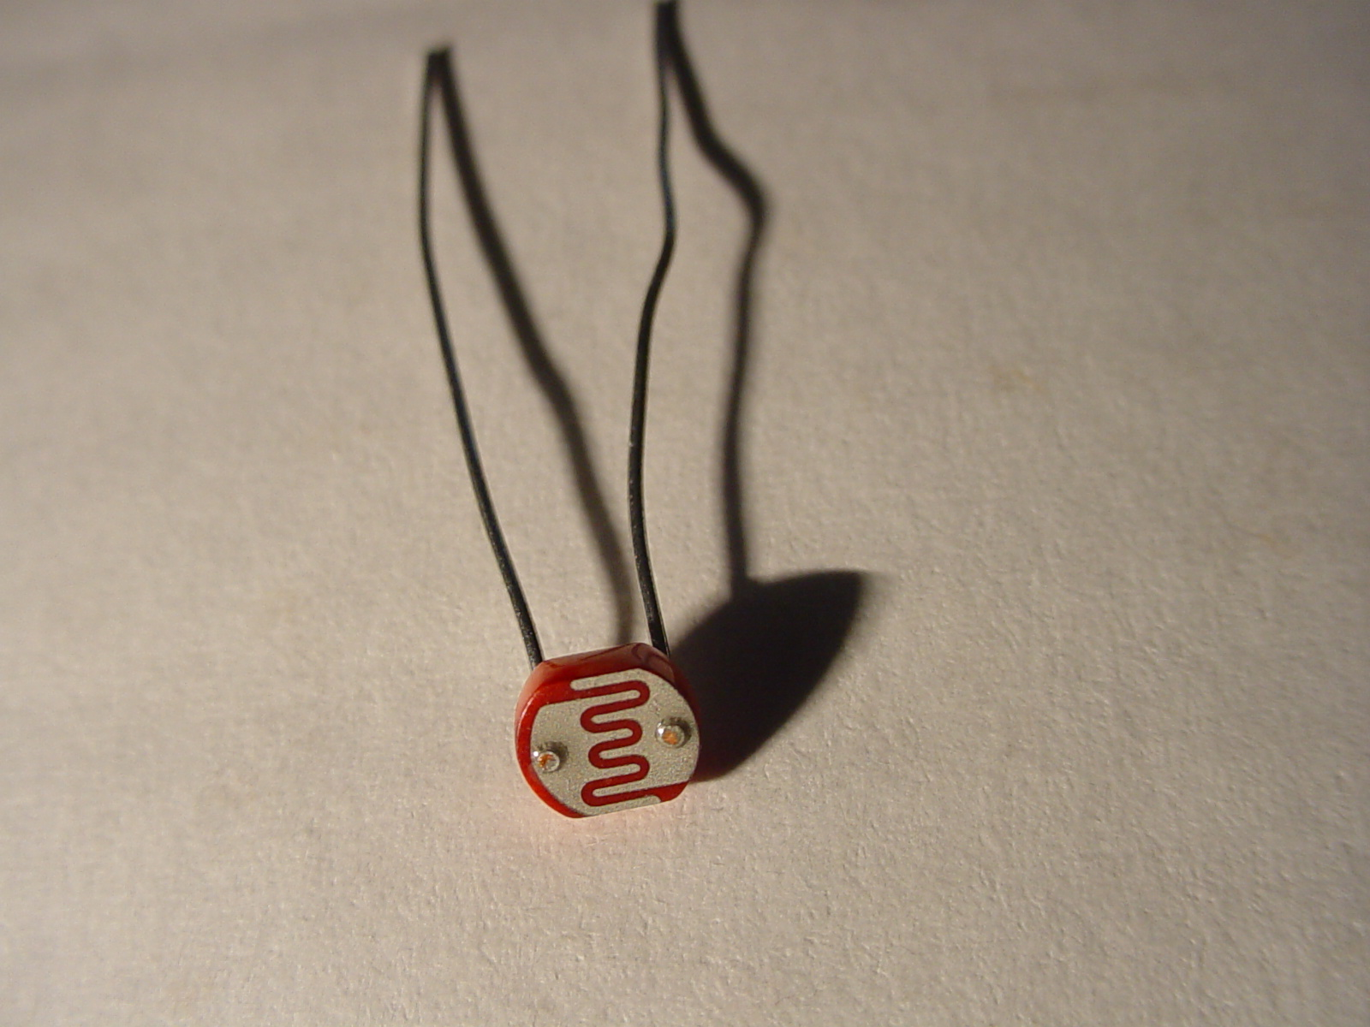
Photocell
Resistance varies with light

Slide 7
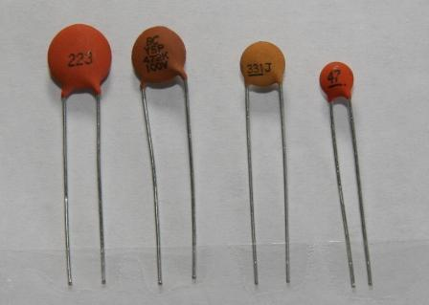

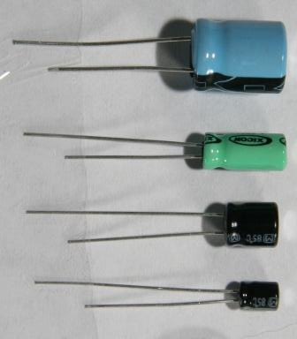

Capacitors: Types
Ceramic (Disc) Capacitors
stores an electrical charge.
Electrolytic (Can) Capacitors
Radial Lead
Notes:
Many other types of capacitors exist. Their names come from the material that makes up the dielectric. The ratings for these capacitors are usually labeled on the device.
Component Identification
Digital Electronics TM
1.1 Foundations and The Board Game Counter
Project Lead The Way, Inc.
Copyright 2009
7

Slide 8
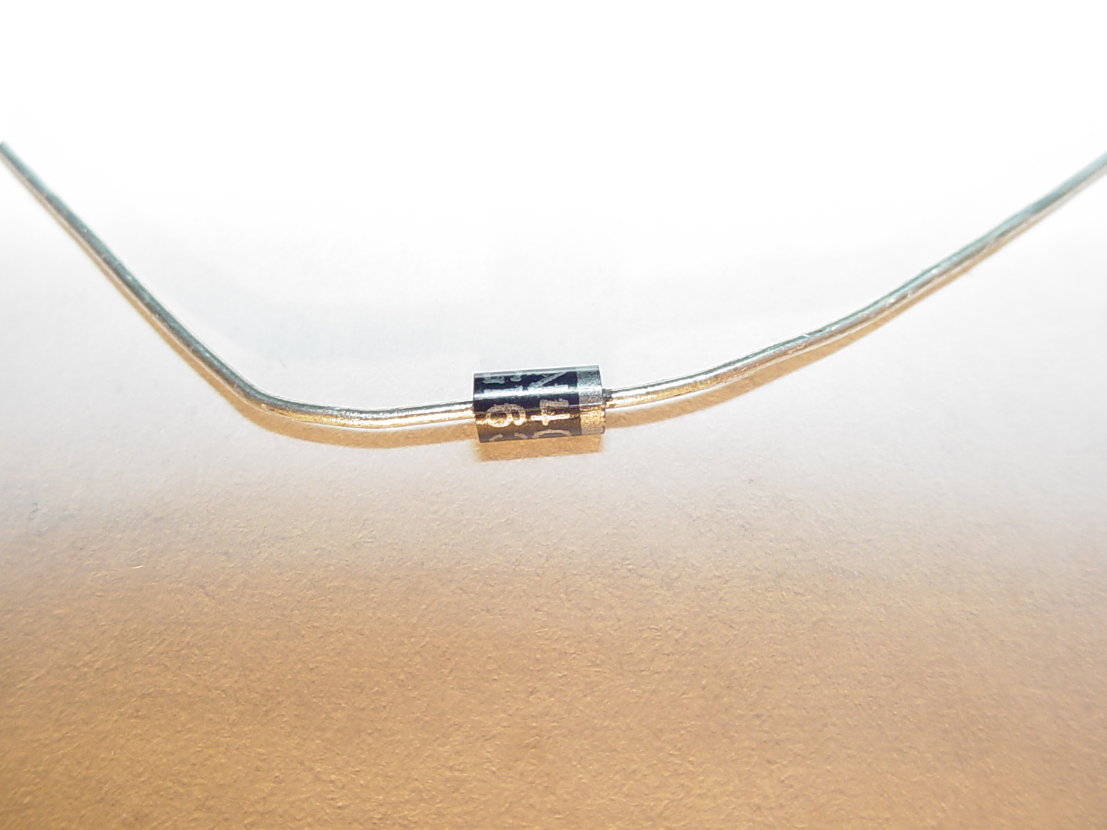
Diode
One-way flow

Slide 9
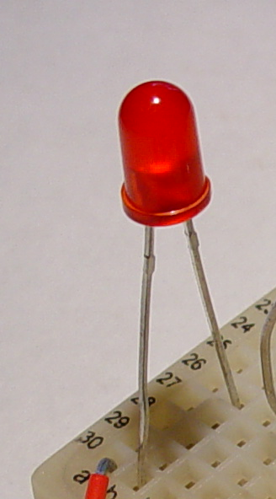
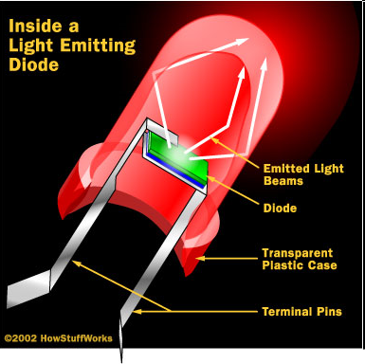
LED
Light Emitting Diode
anode
cathode
Short, flat side = cathode
http://electronics.howstuffworks.com/led3.htm

Slide 10
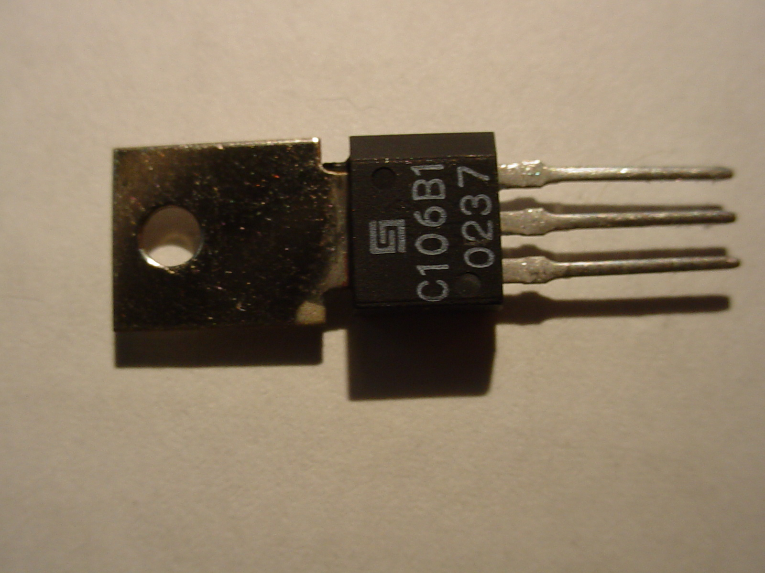
SCR
anode
gate
cathode
Gate
Anode
Cathode

Slide 11
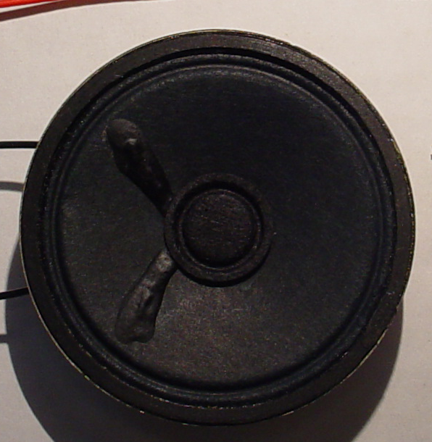
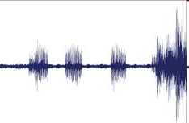
Speaker
schematic
Moves the air to make sound

Slide 12
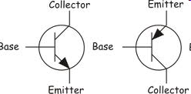
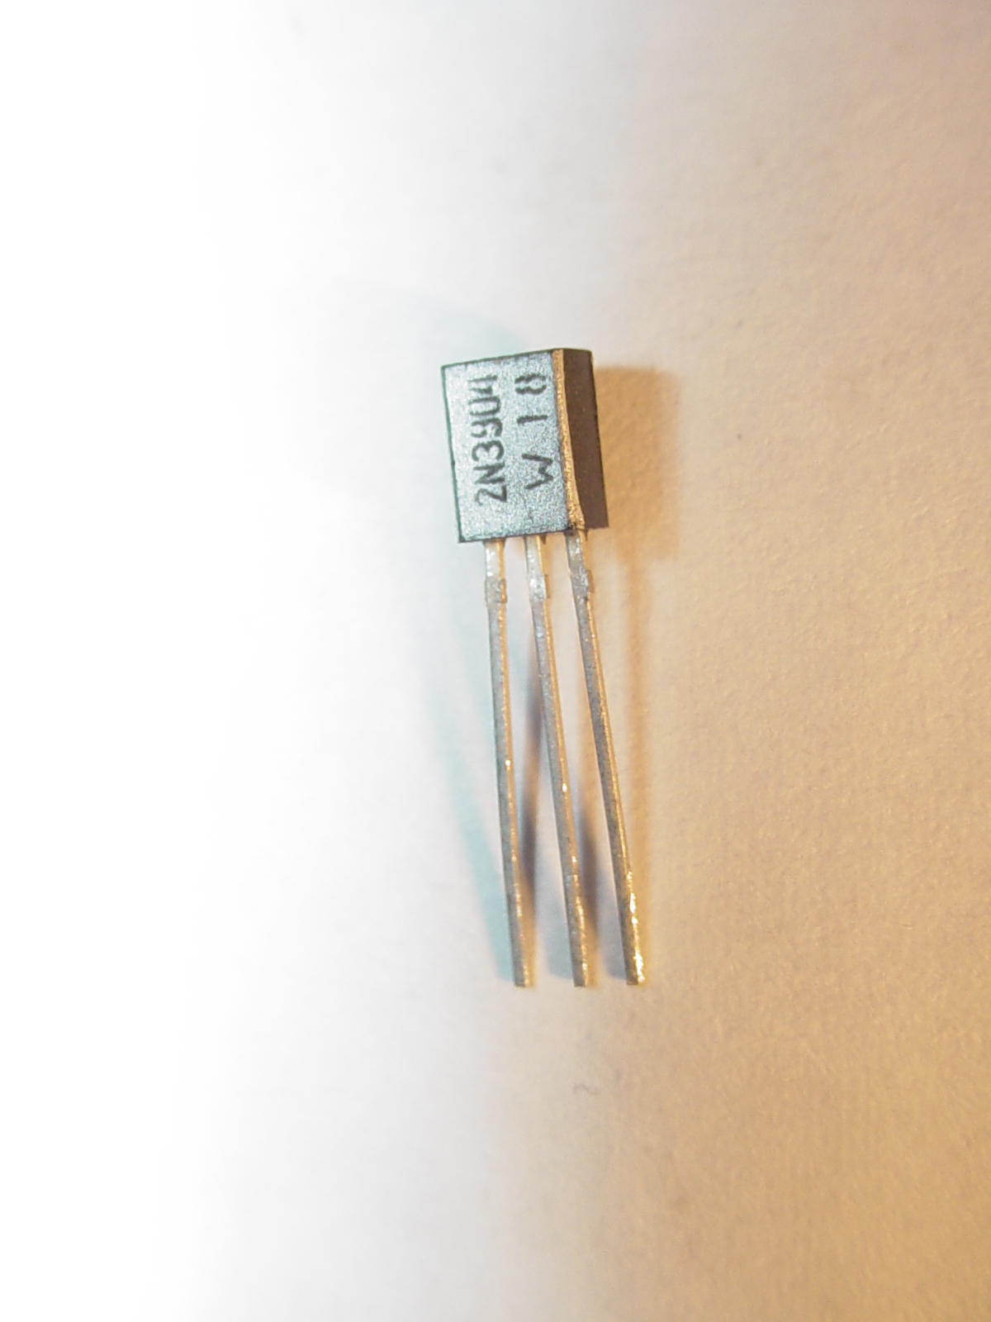
Transistor
NPN PNP
schematics
Electronic on/off switch

Slide 13
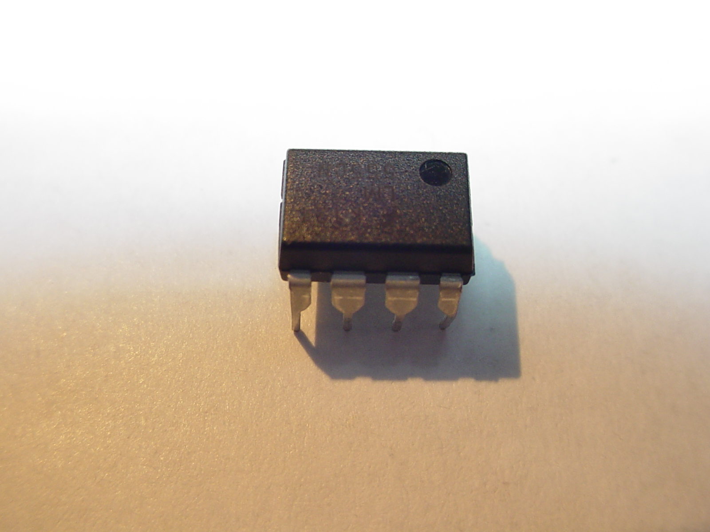
IC
Integrated circuits can be programmed to do anything!

